Slide 1
Basic Linux Commands & Introduction to XV6
Mohammed Elkholy
Allaa Elkhouly
Ahmed Bahusain

Slide 2
TABLE OF CONTENTS
TEAM MEMBERS
PSEUDO-CODE
Roles of each team member in the group
A description of the 3 added user apps and their pseudo-code
XV6 FILES
Which files in XV6 were added/changed to complete the task and why

Slide 3
TEAM MEMBERS
1ST SORTING
ALGORITHM
“RADIX SORT”
AHMED
ALLAA
MOHAMMED
SEARCHING
ALGORITHM
“LINEAR SORT”
2ND SORTING
ALGORITHM
“BUBBLE SORT

Slide 4
PSEUDOCODE AND DESCRIPTION
Our team decided to use the linear search algorithm, the bubble sort algorithm, and the radix sort algorithm.

Slide 5
LINEAR SEARCH PSEUDOCODE
Linear Search ( Array A, Value x)
Step 1: Set i to 1
Step 2: if i > n then go to step 7
Step 3: if A[i] = x then go to step 6
Step 4: Set i to i + 1
Step 5: Go to Step 2
Step 6: Print Element x Found at index i and go to step 8 Step 7: Print element not found
Step 8: Exit

Slide 6
RADIX SORT
PSEUDOCODE
Radix-Sort(A, d)
//It works same as counting sort for d number of passes.
//Each key in A[1..n] is a d-digit integer.
//(Digits are numbered 1 to d from right to left.)
for j = 1 to d do
//A[]-- Initial Array to Sort
int count[10] = {0};
//Store the count of "keys" in count[]
//key- it is number at digit place j
for i = 0 to n do
count[key of(A[i]) in pass j]++
for k = 1 to 10 do
count[k] = count[k] + count[k-1]
//Build the resulting array by checking
//new position of A[i] from count[k]
for i = n-1 downto 0 do
result[ count[key of(A[i])] ] = A[j]
count[key of(A[i])]--
//Now main array A[] contains sorted numbers
//according to current digit place
for i=0 to n do
A[i] = result[i]
end for(j)
end func

Slide 7
BUBBLE SORT
PSEUDOCODE
begin BubbleSort(list)
For (j= 1 to n-j-1)
for all elements of list if list[i] > list[i+1]
swap(list[i], list[i+1])
end if
end for
for for
return list
end BubbleSort

Slide 8
CHANGES IN THE CODE
We needed to include header files included with the xv6 files. Using normal C headers like stdlib and stdio causes errors due to linking problems. Thus we used the defined functions in user.h and other headers for all our functions.
printf FUNCTION
EXIT
We need to pass an int to specify where we want to print. 1 was passed for stdout
We had to use exit() in main when returning as return causes segmentation fault

Slide 9
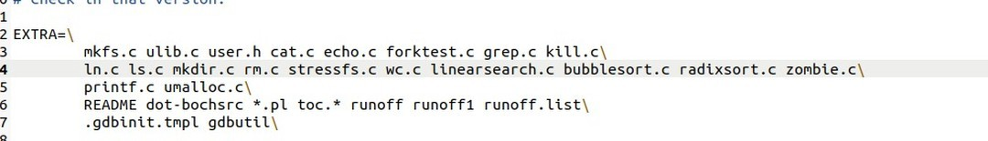
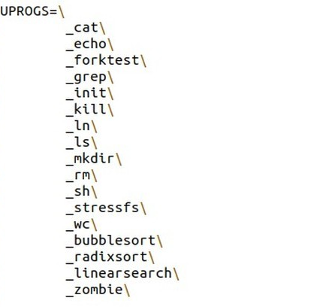
CHANGES IN XV6 FILES
We had to add some parts in the “Makefile”
We added the names of the files as”_filename\”under user program “UPROGS”
We added the file names “filename.c” under “EXTRA=\”

